Slide 1
System design techniques
Design methodologies.
Requirements and specification.

Slide 2
Design methodologies
Process for creating a system.
Many systems are complex:
  large specifications;
  multiple designers;
  interface to manufacturing.
Proper processes improve:
  quality;
  cost of design and manufacture.

Slide 3
Product metrics
Time-to-market:
  beat competitors to market;
  meet marketing window (back-to-school).
Design cost.
Manufacturing cost.
Quality.

Slide 4
Mars Climate Observer
Lost on Mars in September 1999.
Requirements problem:
  Requirements did not specify units.
  Lockheed Martin used English; JPL wanted metric.
Not caught by manual inspections.

Slide 5
Design flow
Design flow: sequence of steps in a design methodology.
May be partially or fully automated.
  Use tools to transform, verify design.
Design flow is one component of methodology. Methodology also includes management organization, etc.

Slide 6
Waterfall model
Early model for software development:
requirements
architecture
coding
testing
maintenance

Slide 7
Waterfall model steps
Requirements: determine basic characteristics.
Architecture: decompose into basic modules.
Coding: implement and integrate.
Testing: exercise and uncover bugs.
Maintenance: deploy, fix bugs, upgrade.

Slide 8
Waterfall model critique
Only local feedback---may need iterations between coding and requirements, for example.
Doesn’t integrate top-down and bottom-up design.
Assumes hardware is given.

Slide 9
Spiral model
system feasibility
specification
prototype
initial system
enhanced system
requirements
design
test

Slide 10
Spiral model critique
Successive refinement of system.
  Start with mock-ups, move through simple systems to full-scale systems.
Provides bottom-up feedback from previous stages.
Working through stages may take too much time.

Slide 11
Successive refinement model
specify
specify
architect
architect
design
design
build
build
test
test
initial system
refined system

Slide 12
Hardware/software design flow
requirements and
specification
architecture
hardware design
software design
integration
testing

Slide 13
Co-design methodology
Must architect hardware and software together:
  provide sufficient resources;
  avoid software bottlenecks.
Can build pieces somewhat independently, but integration is major step.
Also requires bottom-up feedback.

Slide 14
Hierarchical design flow
Embedded systems must be designed across multiple levels of abstraction:
  system architecture;
  hardware and software systems;
  hardware and software components.
Often need design flows within design flows.

Slide 15
Hierarchical HW/SW flow
spec
spec
spec
architecture
HW architecture
SW architecture
detailed design
HW
SW
detailed design
integrate
integration
integration
test
test
test
system
hardware
software

Slide 16
Concurrent engineering
Large projects use many people from multiple disciplines.
Work on several tasks at once to reduce design time.
Feedback between tasks helps improve quality, reduce number of later design problems.

Slide 17
Concurrent engineering techniques
Cross-functional teams.
Concurrent product realization.
Incremental information sharing.
Integrated product management.
Supplier involvement.
Customer focus.

Slide 18
AT&T PBX concurrent engineering
Benchmark against competitors.
Identify breakthrough improvements.
Characterize current process.
Create new process.
Verify new process.
Implement.
Measure and improve.

Slide 19
Requirements analysis
Requirements: informal description of what customer wants.
Specification: precise description of what design team should deliver.
Requirements phase links customers with designers.

Slide 20
Types of requirements
Functional: input/output relationships.
Non-functional:
  timing;
  power consumption;
  manufacturing cost;
  physical size;
  time-to-market;
  reliability.

Slide 21
Good requirements
Correct.
Unambiguous.
Complete.
Verifiable: is each requirement satisfied in the final system?
Consistent: requirements do not contradict each other.

Slide 22
Good requirements, cont’d.
Modifiable: can update requirements easily.
Traceable:
  know why each requirement exists;
  go from source documents to requirements;
  go from requirement to implementation;
  back from implementation to requirement.

Slide 23
Setting requirements
Customer interviews.
Comparison with competitors.
Sales feedback.
Mock-ups, prototypes.
Next-bench syndrome (HP): design a product for someone like you.

Slide 24
Specifications
Capture functional and non-functional properties:
  verify correctness of spec;
  compare spec to implementation.
Many specification styles:
  control-oriented vs. data-oriented;
  textual vs. graphical.
UML is one specification/design language.

Slide 25
SDL
Used in telecommunications protocol design.
Event-oriented state machine model.
telephone
on-hook
caller goes
off-hook
dial tone
caller gets
dial tone

Slide 26
Statecharts
Ancestor of UML state diagrams.
Provided composite states:
  OR states;
  AND states.
Composite states reduce the size of the state transition graph.

Slide 27
Statechart OR state
s123
i1
i1
S1
S1
i2
i1
i1
i2
i2
S2
S4
S2
S4
i2
S3
S3
traditional
OR state

Slide 28
Statechart AND state
sab
c
S1-3
S1-4
S1
S3
d
b
a
b
a
b
a
c
d
c
S2-3
S2-4
S2
S4
d
r
r
r
S5
S5
traditional
AND state

Slide 29
AND-OR tables
Alternate way of specifying complex conditions:
cond1 or (cond2 and !cond3)
cond1 T -
cond2 - T
cond3 - F
OR
AND

Slide 30
TCAS II specification
TCAS II: aircraft collision avoidance system.
Monitors aircraft and air traffic info.
Provides audio warnings and directives to avoid collisions.
Leveson et al used RMSL language to capture the TCAS specification.

Slide 31
RMSL
State description:
Transition bus for transitions between many states:
state1
inputs
a
state description
b
c
outputs
d

Slide 32
TCAS top-level description
CAS
power-off
power-on
Inputs:
TCAS-operational-status {operational,not-operational}
fully-operational
own-aircraft
C
other-aircraft i:[1..30]
standby
mode-s-ground-station i:[1..15]

Slide 33
Own-Aircraft AND state
CAS
Inputs:
own-alt-radio: integer standby-discrete-input: {true,false}
own-alt-barometric:integer, etc.
Effective-SL
Alt-SL
Alt-layer
Climb-inibit
Descend-inibit
...
...
1
1
...
Increase-climb-inibit
2
2
...
...
...
...
Increase-Descend-inibit
Advisory-Status
...
7
7
Outputs:
sound-aural-alarm: {true,false} aural-alarm-inhibit: {true, false}
combined-control-out: enumerated, etc.

Slide 34
CRC cards
Well-known method for analyzing a system and developing an architecture.
CRC:
  classes;
  responsibilities of each class;
  collaborators are other classes that work with a class.
Team-oriented methodology.

Slide 35
CRC card format
Class name:
Superclasses:
Subclasses:
Responsibilities: Collaborators:
Class name:
Class’s function:
Attributes:
front
back

Slide 36
CRC methodology
Develop an initial list of classes.
  Simple description is OK.
  Team members should discuss their choices.
Write initial responsibilities/collaborators.
  Helps to define the classes.
Create some usage scenarios.
  Major uses of system and classes.

Slide 37
CRC methodology, cont’d.
Walk through scenarios.
  See what works and doesn’t work.
Refine the classes, responsibilities, and collaborators.
Add class relatoinships:
  superclass, subclass.

Slide 38
CRC cards for elevator
Real-world classes:
  elevator car, passenger, floor control, car control, car sensor.
Architectural classes: car state, floor control reader, car control reader, car control sender, scheduler.

Slide 39
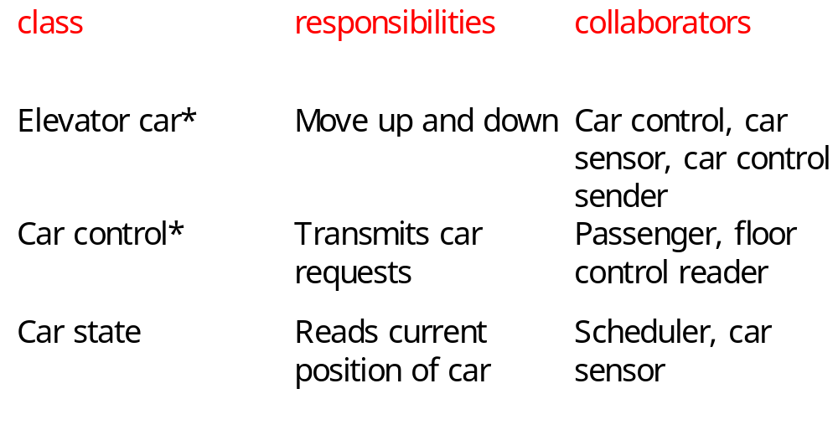
Elevator responsibilities and collaborators

